Slide 1

Vasuda Trehan
Srinivas Hanumansetty
Simar Singh
Mckenna Miranda
Presidential Election Analysis 2020

Slide 2
For our final project we will be analyzing US midterm election data from 2018 and 2014. The datasets we have initially chosen date back to 1976, providing enough data to look further back in time for trends if necessary. Our main focus is analyzing trends from the past six years to determine political trends. Looking at party affiliation and voter turnout by population will give us an opportunity to visualize possible trends. Our current goal is to analyze our data for trends then, moving onto training and testing our data with a machine learning library. Our stretch goal is to analyze the presidential election data from 2016, 2012, and 2008 to predict the outcome of this year’s (2020) election.

Slide 3
Research Outcomes
Elected Party Affiliation by State
Senate and House Candidacy Trends
Increase /decrease in voter participation in midterm elections
Voter demographic trends per election

Slide 4
Breakdown Of Tasks
Vasuda : Data Cleaning, Machine Learning, Analysis, Visualizations (Presidential State Data)
McKenna : Data Cleaning, Machine Learning, Analysis, Visualizations (House_Data)
Simar : SQL, AWS, Local Host,Presentation
Srinivas: Data Cleaning, Machine Learning, Analysis, Visualizations (Senate_Data)
Akash : Presentation

Slide 5
Data Sources
https://electionlab.mit.edu/data
https://www.kaggle.com/eliasdabbas/us-midterm-elections-2018-on-google-search
https://www.kaggle.com/benhamner/2016-us-election?select=primary_results.csv

Slide 6
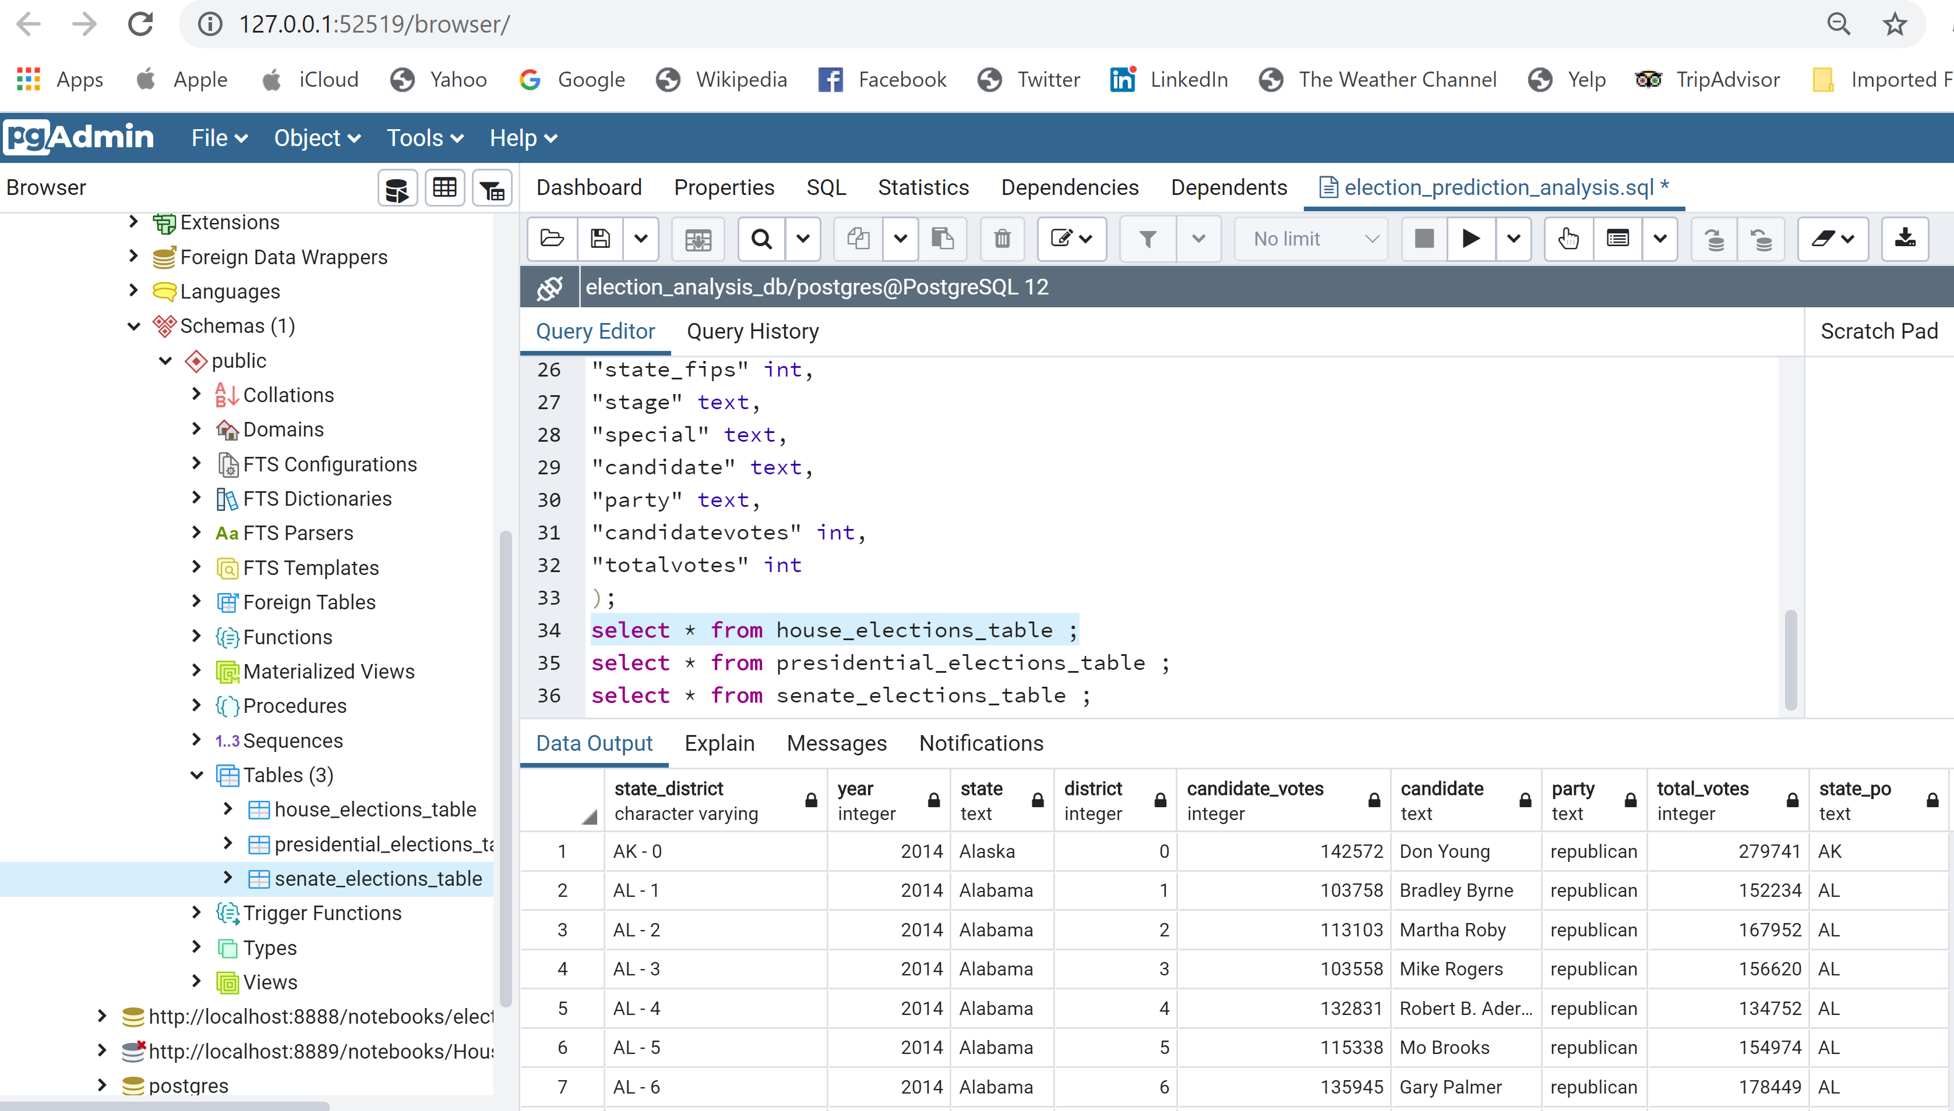
Pg Admin Work House Elections Table

Slide 7
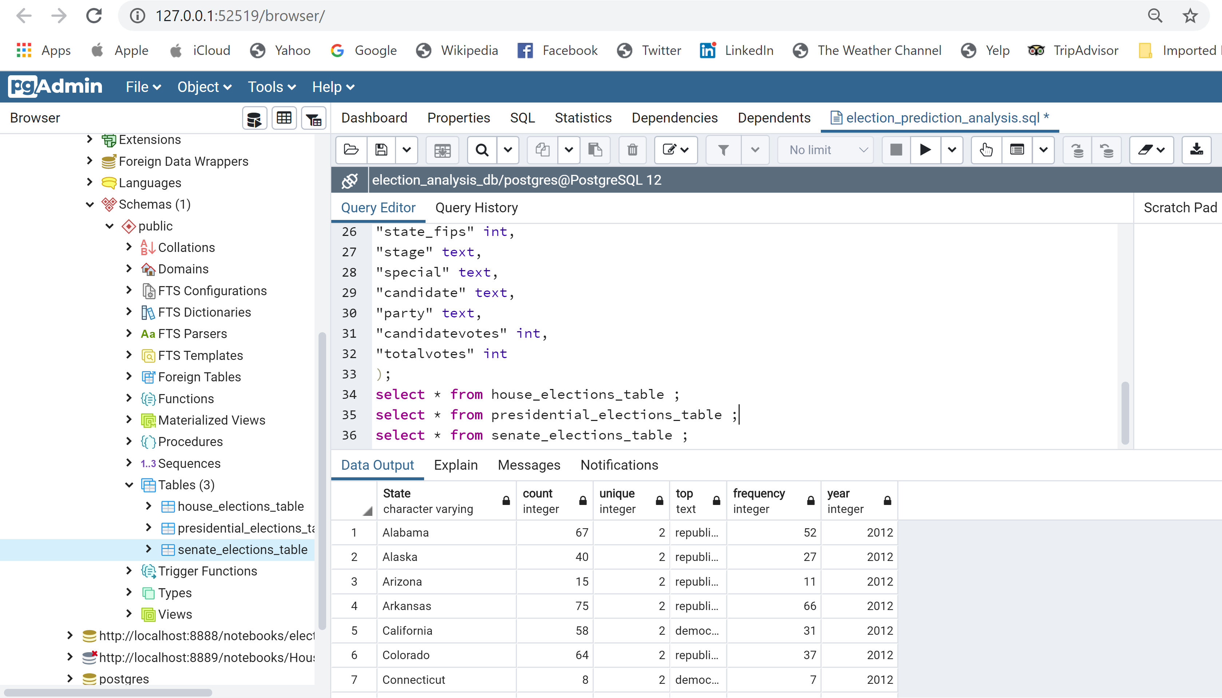
Presidential Elections Table

Slide 8
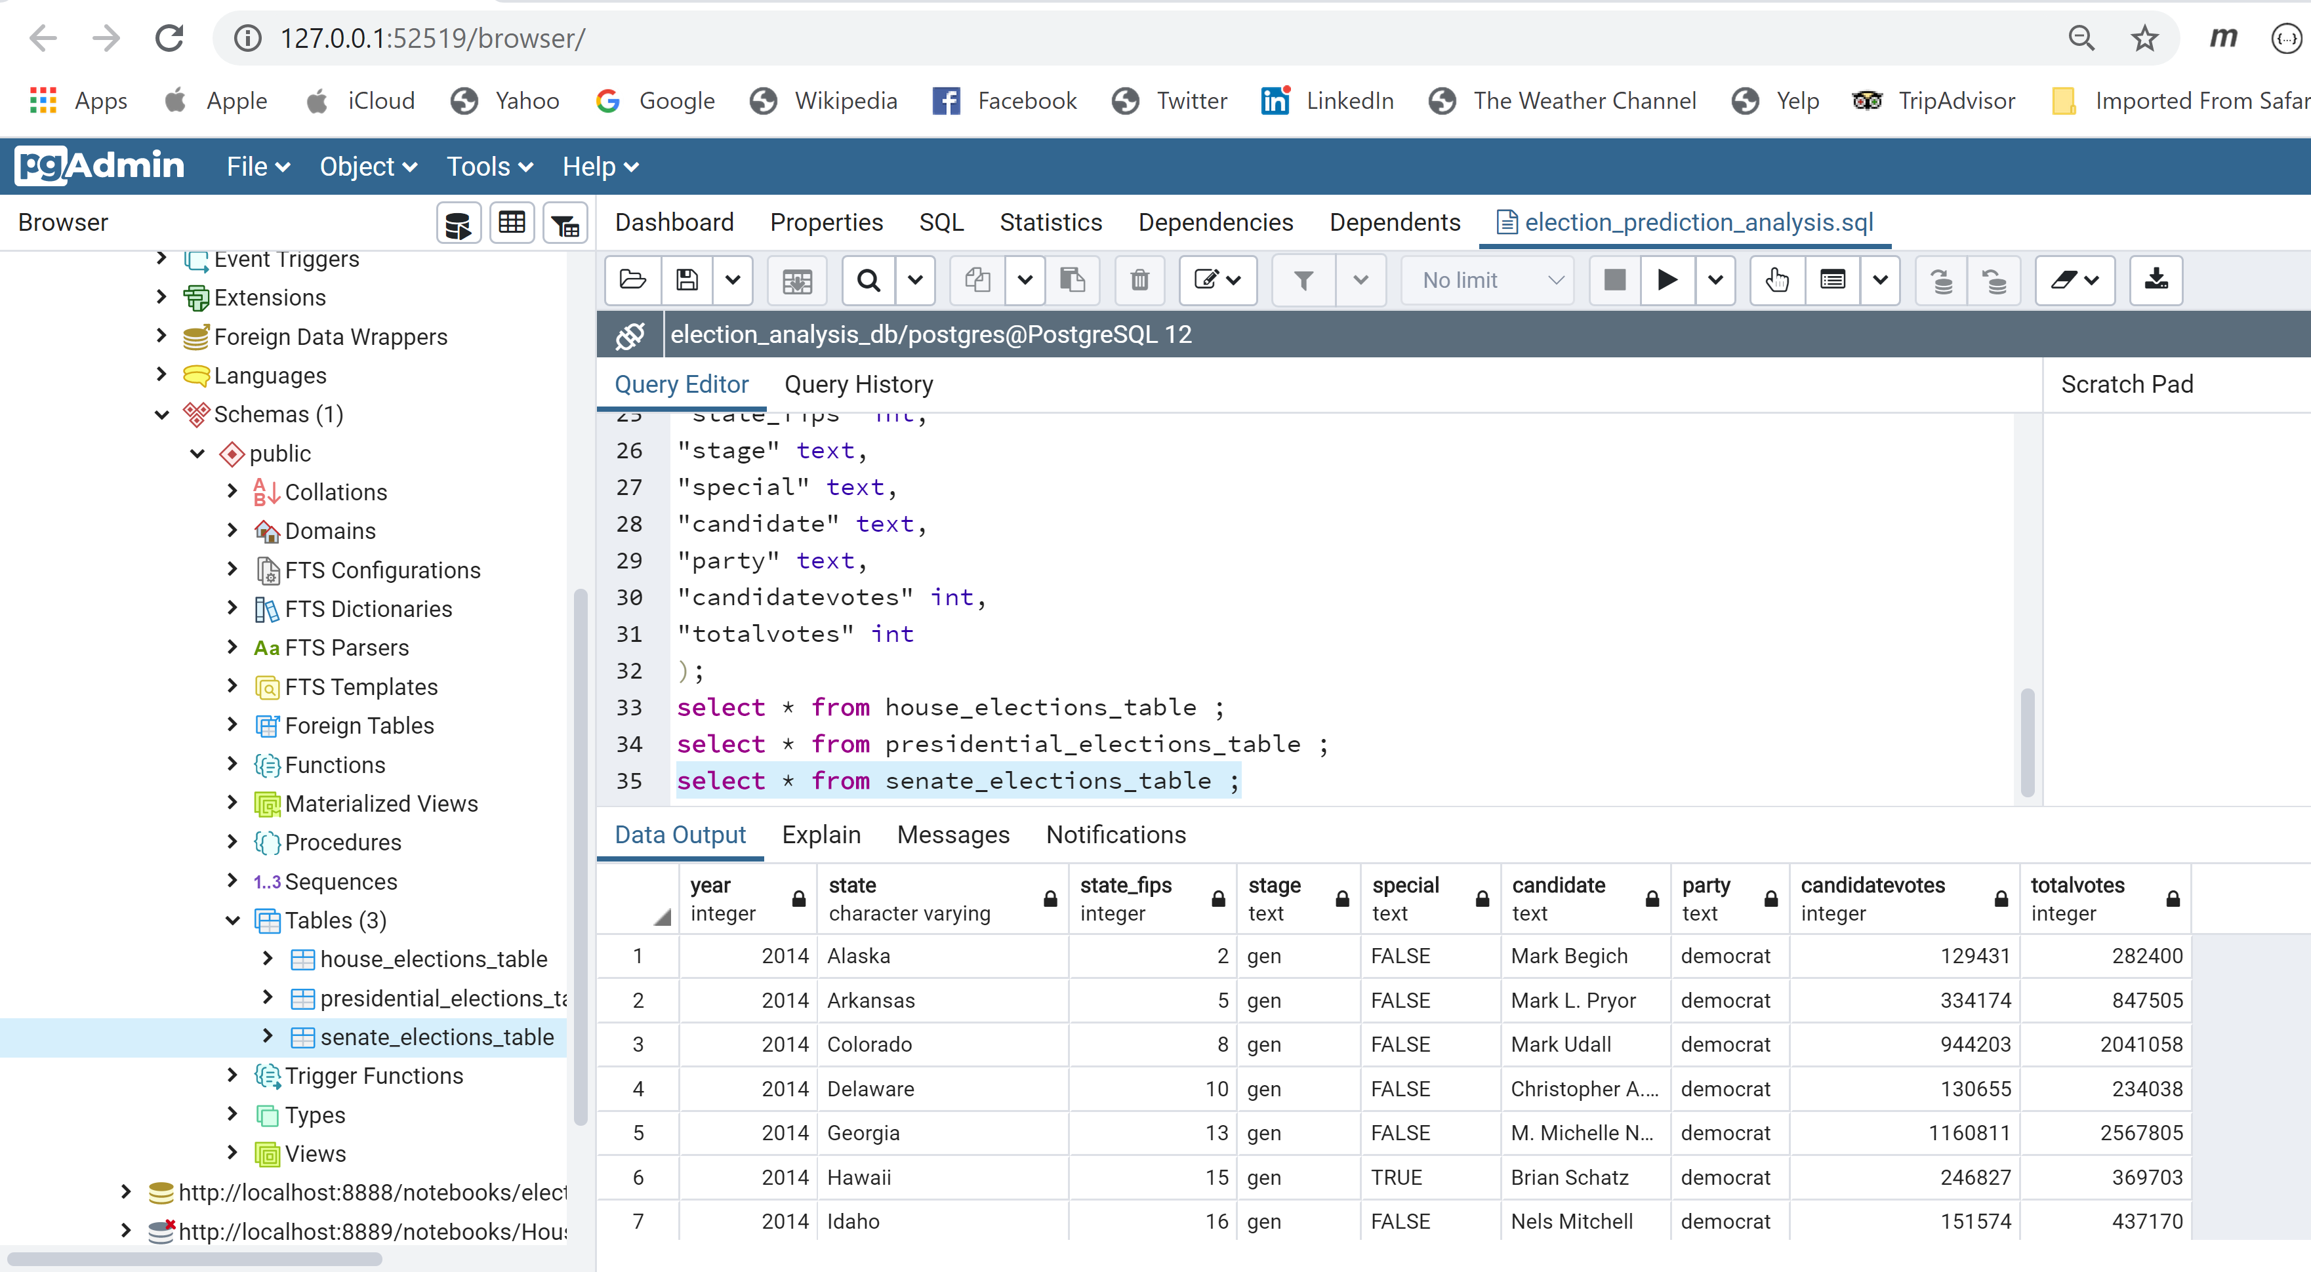
Senate Elections Table

Slide 9
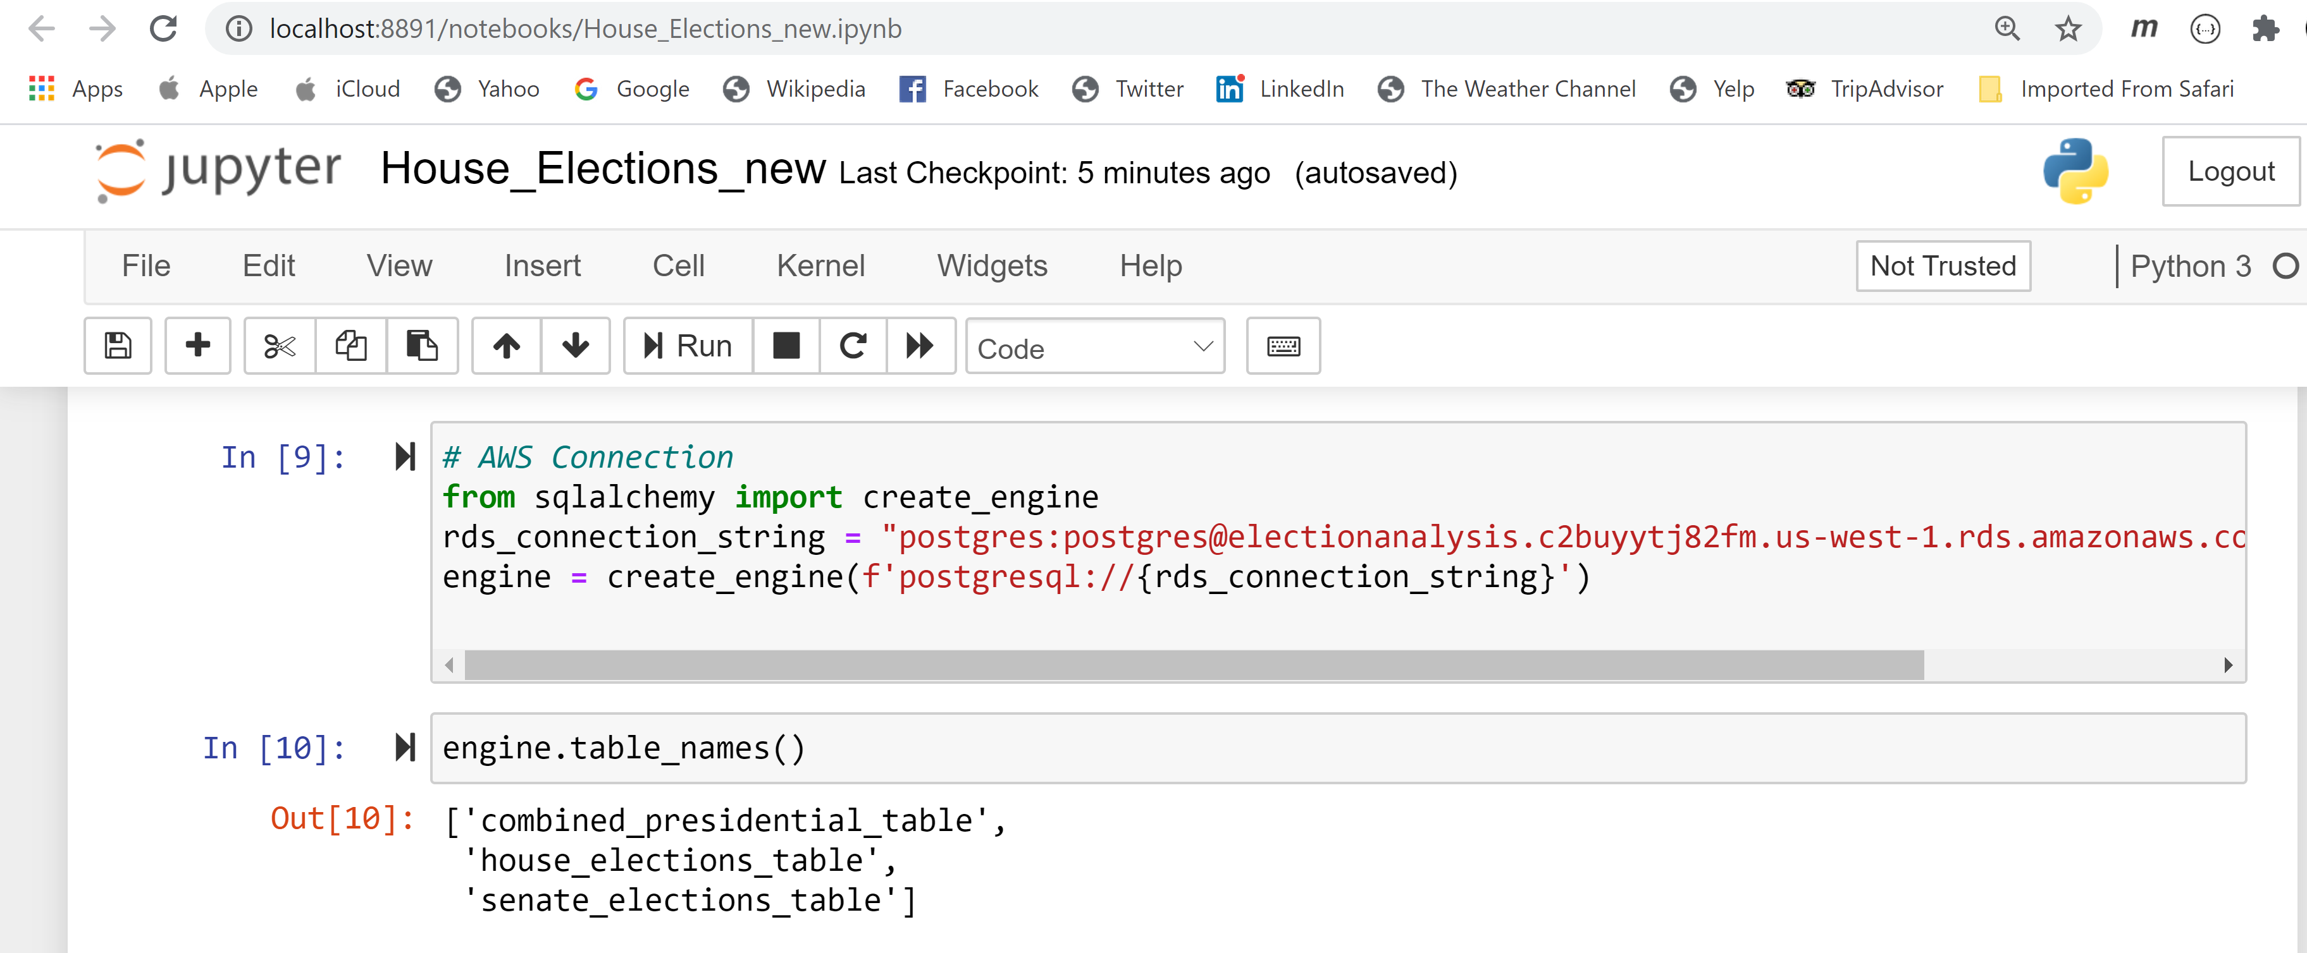
AWS Connection With Database

Slide 10
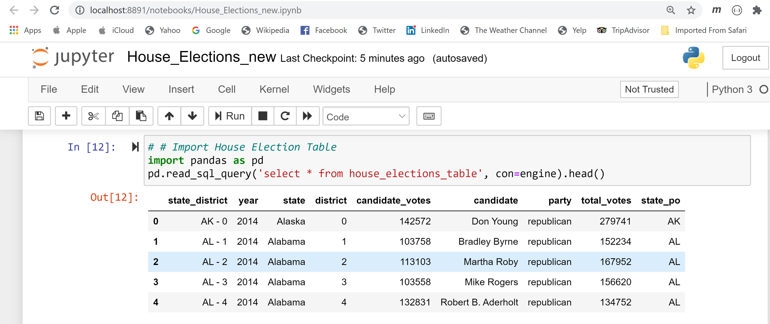
House Election Table

Slide 11
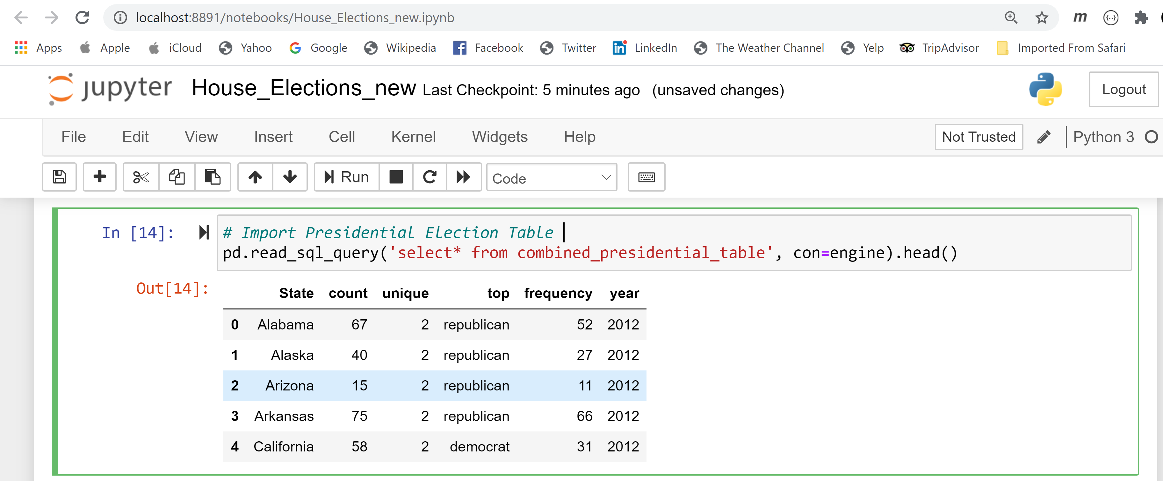
Presidential ElectionTable

Slide 12
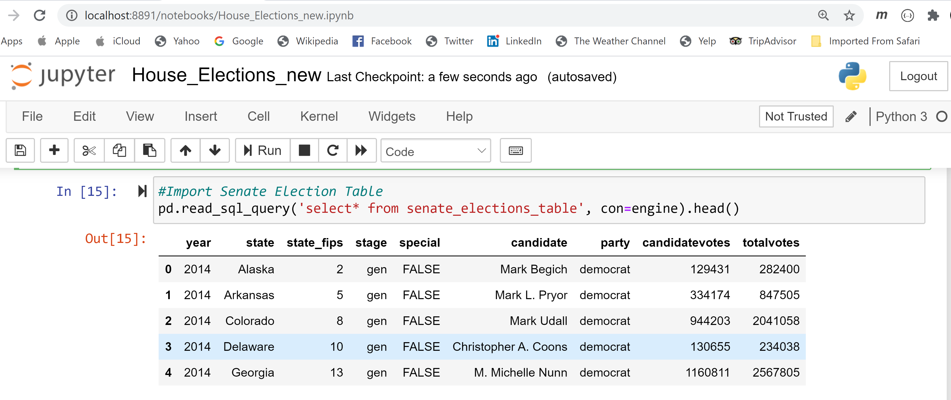
Senate Election Table

Slide 13
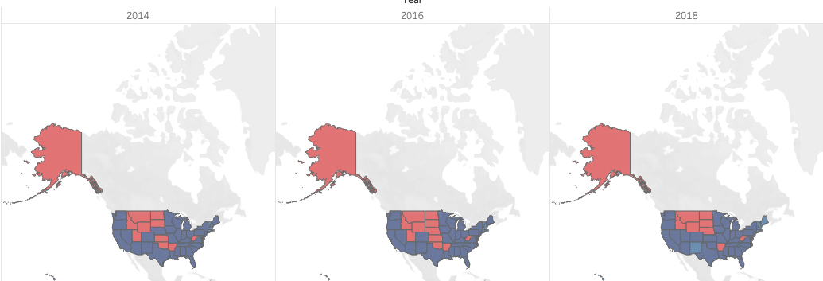
States by Party in House of Representatives

Slide 14
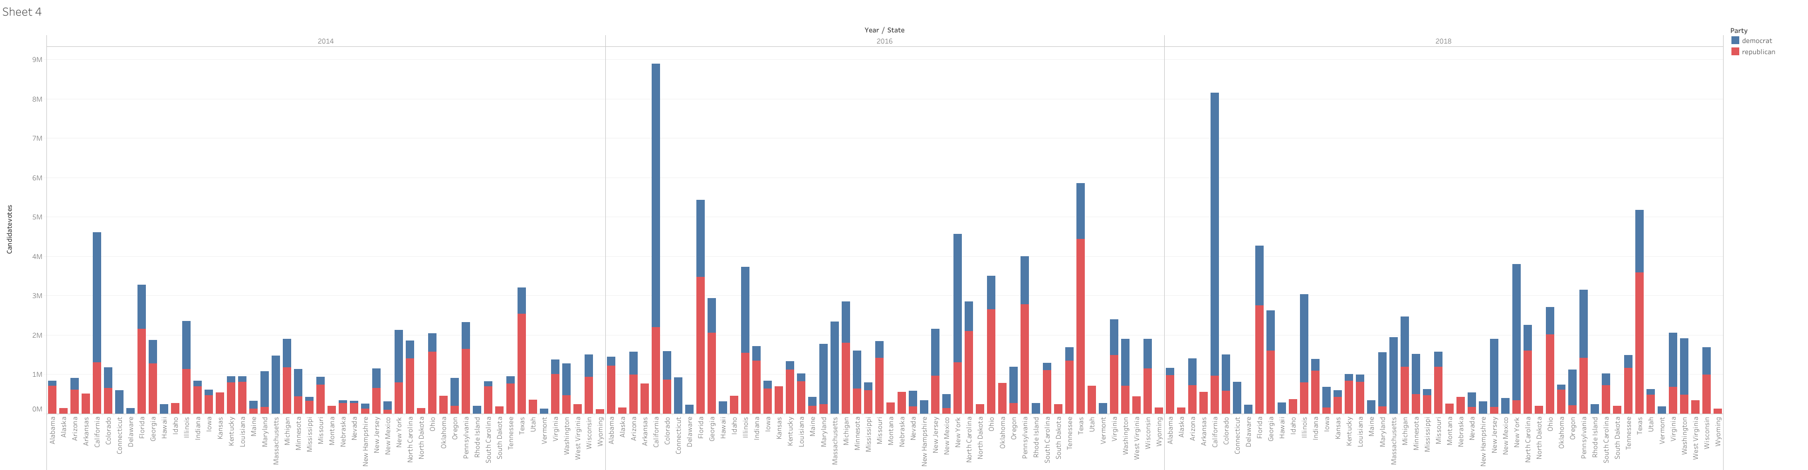
Votes by Party in House Elections
2014
2016
2018

Slide 15
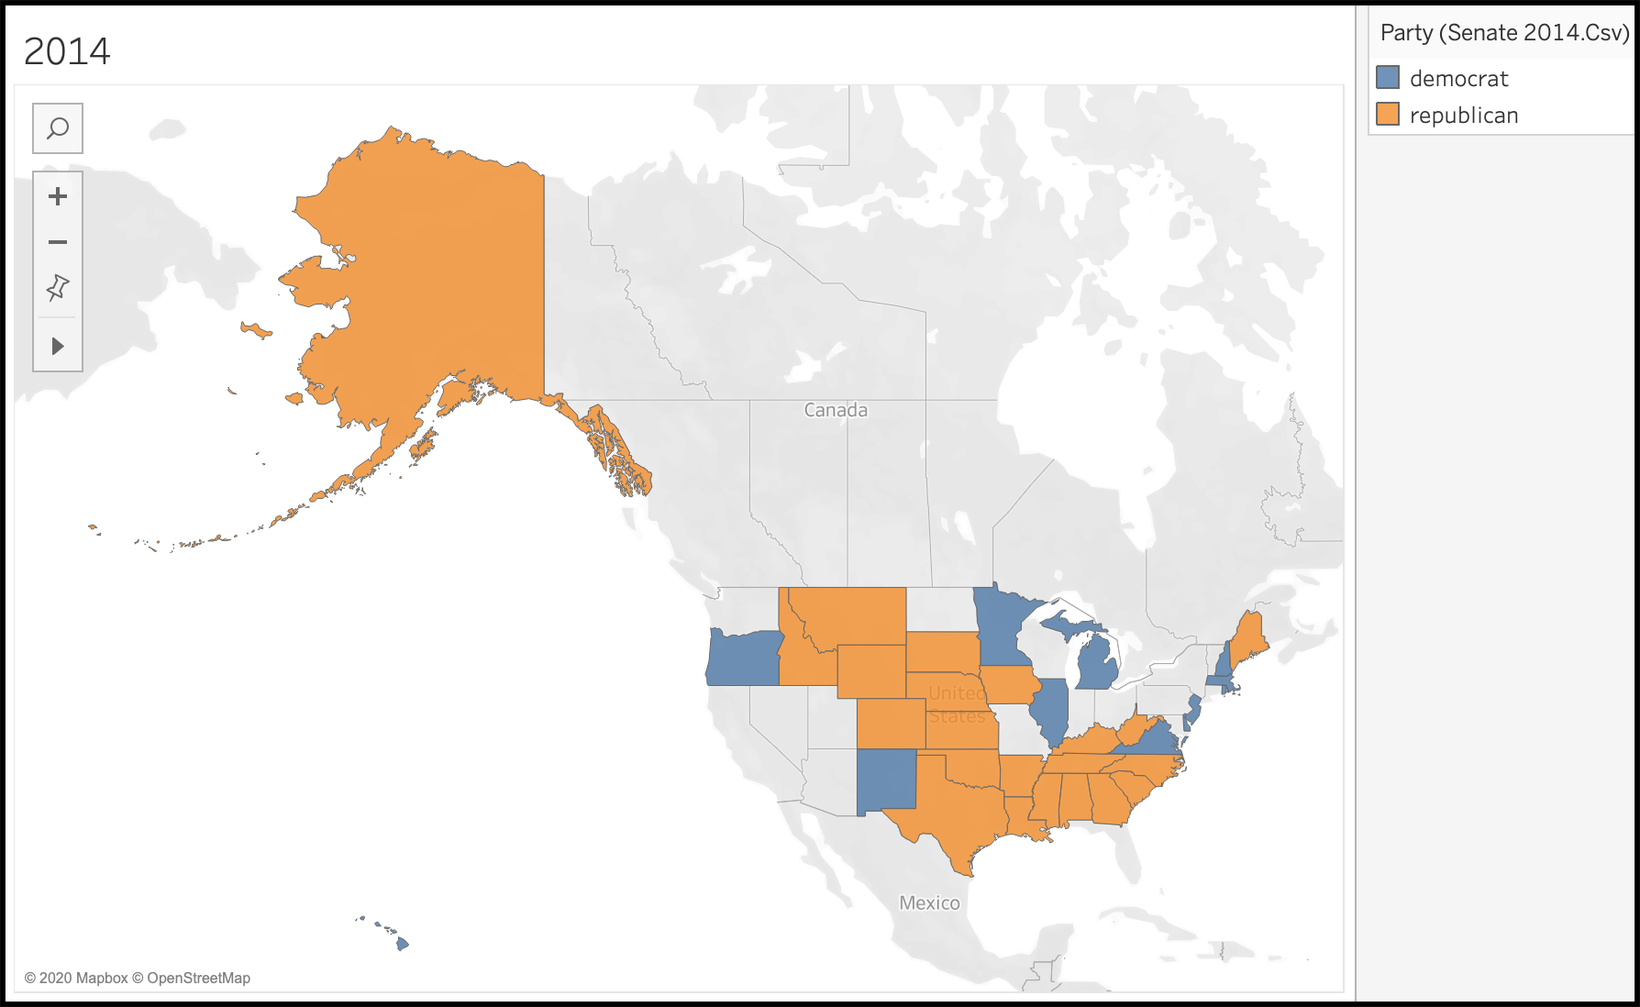
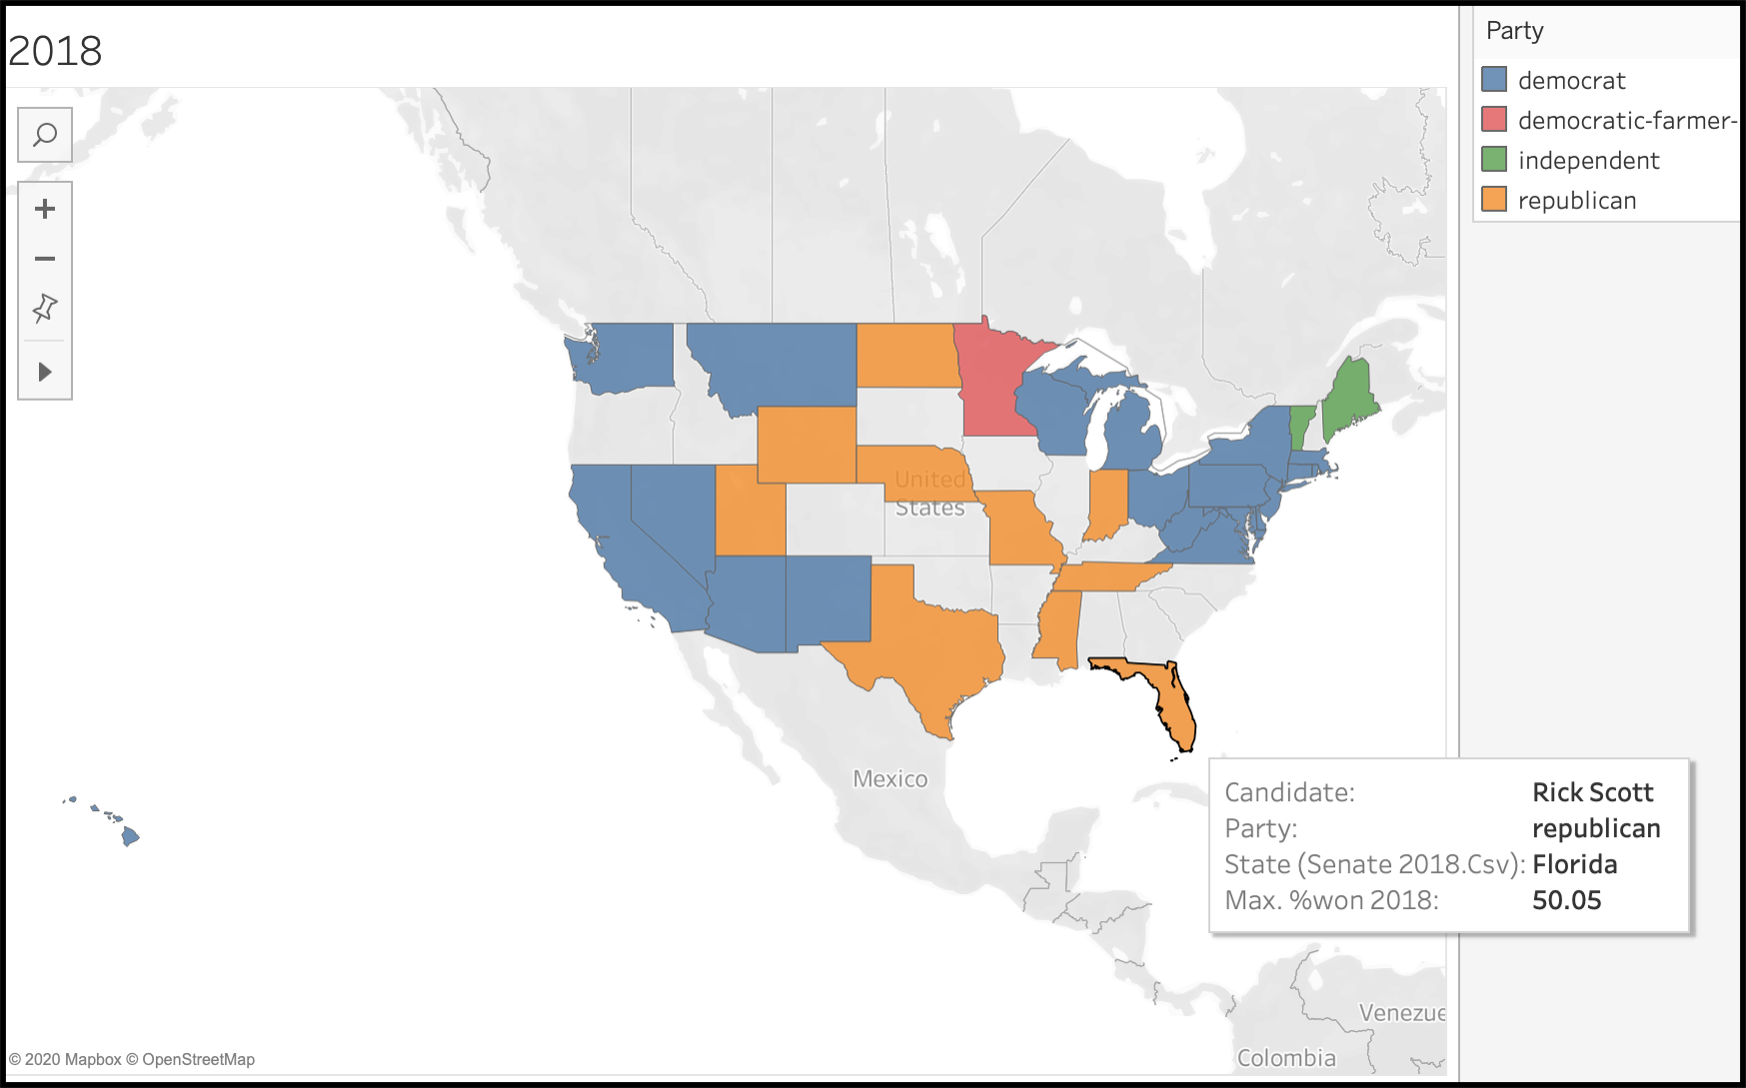
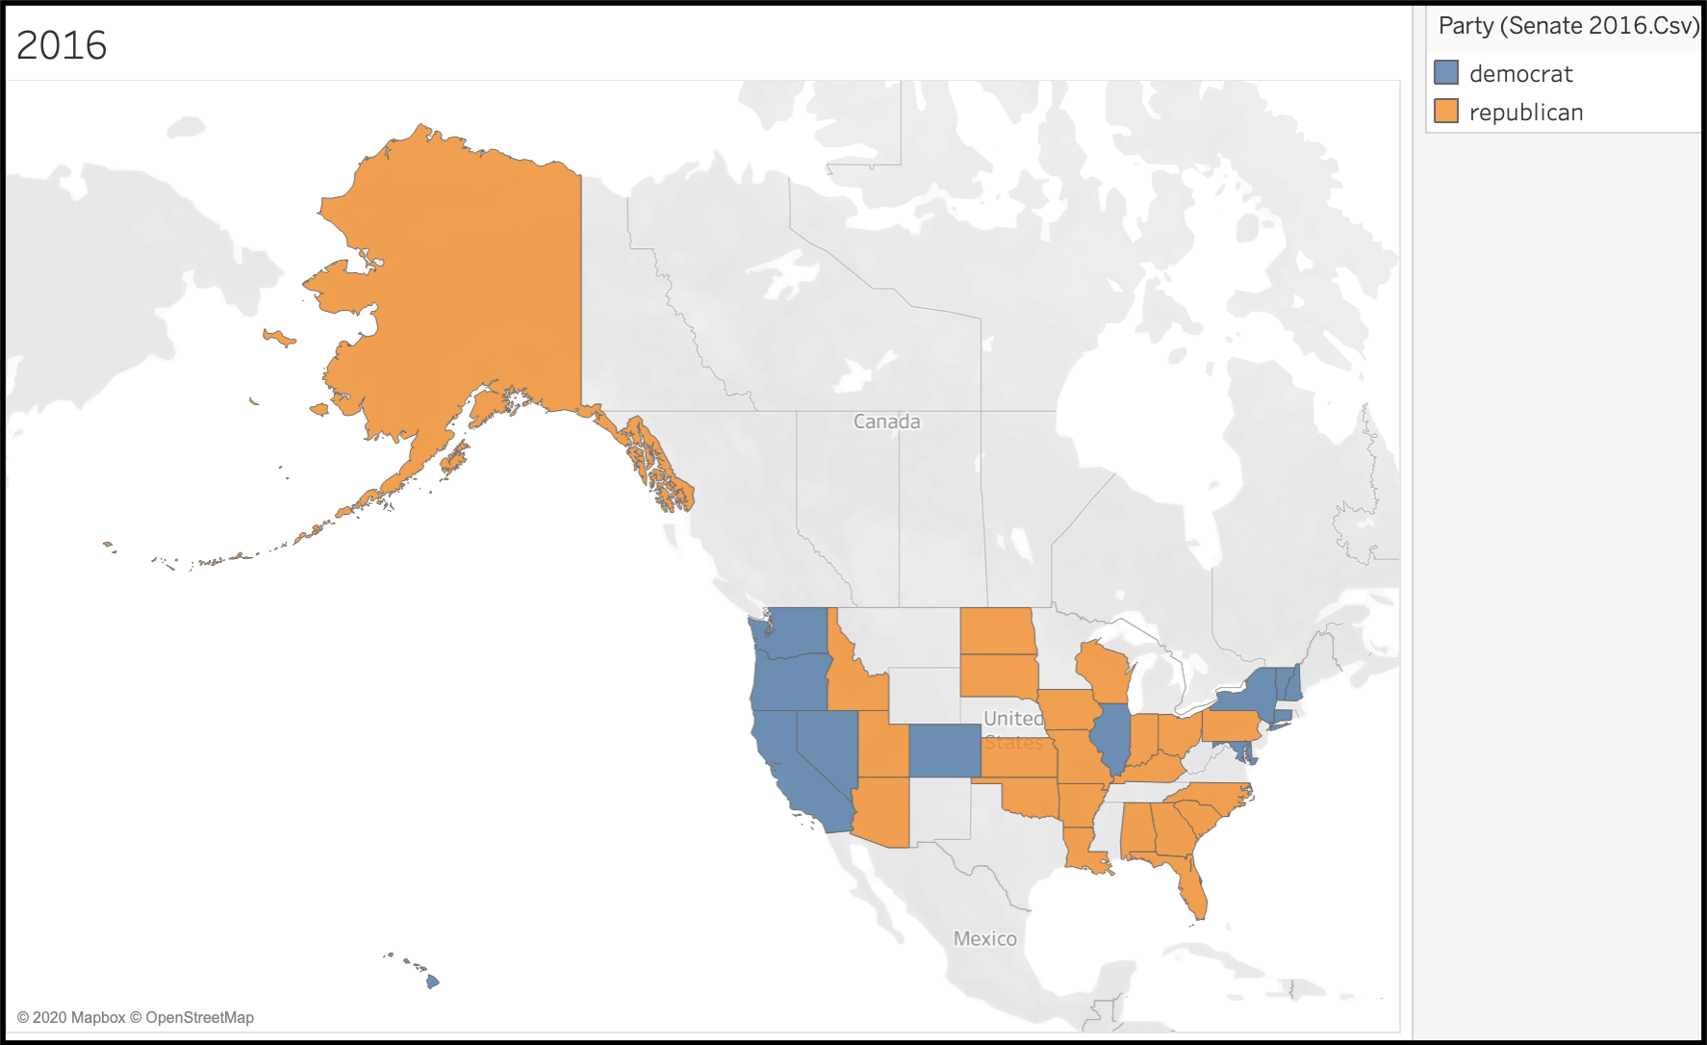
Senate Data

Slide 16
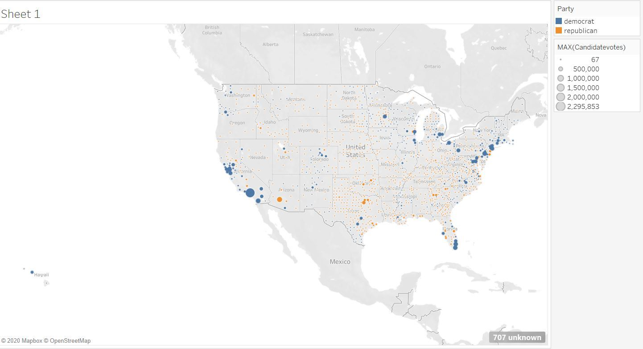
Presidential Election 2008

Slide 17
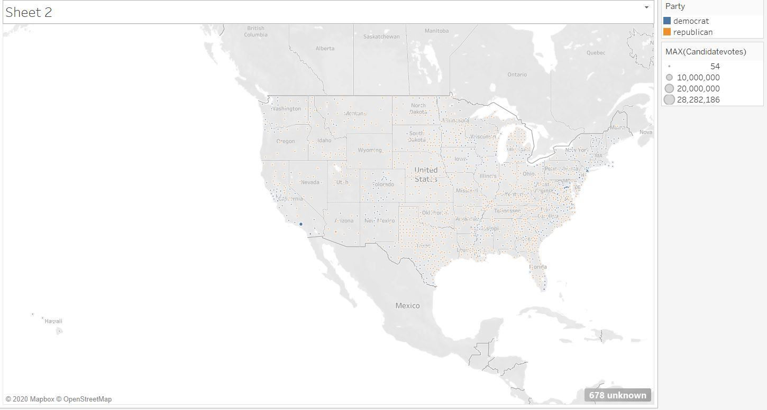
Presidential Election 2012

Slide 18
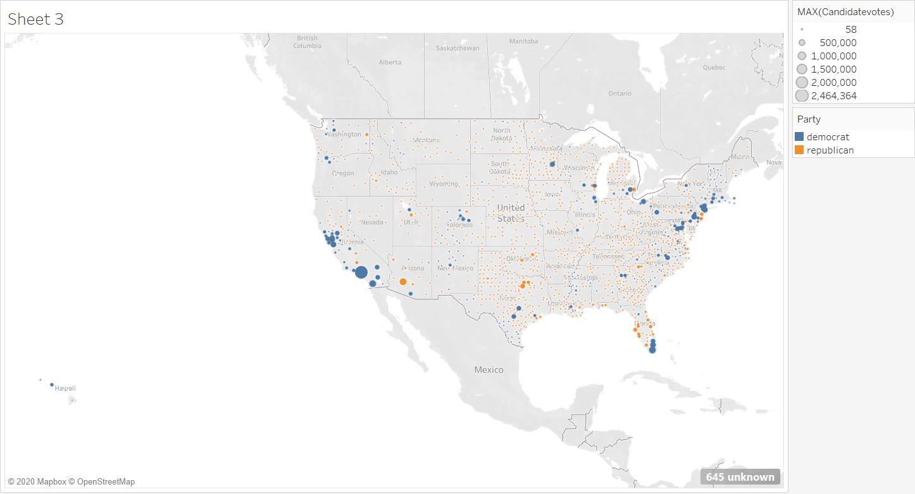
Presidential Election 2016

